Slide 1
Data Mining and Machine Learning
Project - Study of the effects of climatic conditions on alcohol consumption and the study of road accident fatalities
Name – Soham Sameer More (x19149140)

Slide 2
Objective and Research Questions
Objective:
1. To understand and study the correlation between weather and alcohol consumption patterns in the state of Iowa in USA.
2. To understand and study the factors influencing a fatality in a road accident.
Research Questions:
RQ1. How are alcohol sales correlated to weather in the state of Iowa, USA?
RQ2. How are road accident fatalities related to weather conditions, light conditions, the severity of the accident, the influence of drug and alcohol, the major cause of an accident, extent of property damage, and road conditions?

Slide 3
Methodology
Steps taken:
1
Data sourcing.
2
Data understanding and cleaning.
3
Modeling.
4
Evaluation.

Slide 4
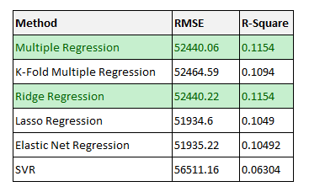
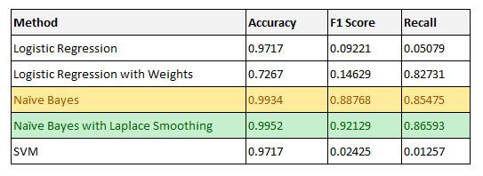
Evaluation
Effects of weather on alcohol consumption
Predicting a fatality in road accidents

Slide 5
Future Work
Weather and Alcohol
Consider the distribution of weather stations and liquor stores.
Reliable source of weather data.
Advanced machine learning models.
Accidents
Use of Geolocation.
Validation of this study with data from other regions.

Slide 6
Thank You!

